Slide 1
Stream Analytics
Ride the river of data

Slide 2
Scenarios
We’ve got too much data coming through the system to save it all
We really don’t need detailed data so much as aggregates
We need to do real-time alerting

Slide 3

A bunch of pipes

Slide 4
Inputs
Event Hub
IoT Hub
Blob Storage

Slide 5
Outputs
Event Hubs
SQL Storage
Blob Storage
Table Storage
Service Bus (topics and queues)
CosmosDB
PowerBI
Data Lake
Azure Funtions

Slide 6
Sampling

Slide 7
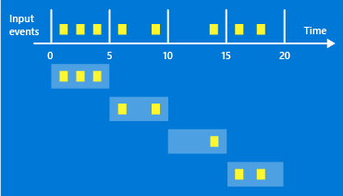
Sliding Windows

Slide 8
Tumbling Windows

Slide 9
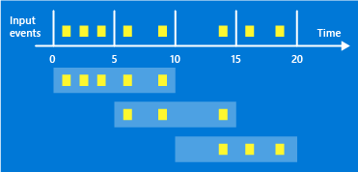
Hopping Windows

Slide 10
Combining Data from Other Sources
Joins are temporal in nature
Reference data joins are not temporal in nature
Notes:
Joins happen across time so you can join records that come in some time apart. Inner joins only return records where there are temporal matches and outer joins will return even when there isn’t a matching record. These can be used to match events together like an entry and exit event. You can, of course, cross data against itself.
Reference joins are for looking up static data. Say looking up if a vehicle is registered as it passes through a check point.

Slide 11
Augmenting with Functions
You can call arbitrary Azure Functions
We’ll look at this coming up later today

Slide 12
Gotchas
Slow to start up and shutdown
Error messages aren’t great

Slide 13
Find out more
https://docs.microsoft.com/en-us/azure/stream-analytics/
http://www.prairiedevcon.com/

Slide 14
Steps
Create a new stream analytics resource
Add an input from your IoT hub
Add 3 CosmosDB outputs to Stream Analytics
rawData
rollingAverages
temperature
Create a query to map inputs to output

Slide 15
rawData
SELECT
*
INTO
rawData
FROM
iothub

Slide 16
rollingAverages
select
DeviceId as Id,
System.timestamp as outputtime,
AVG(temperature),
DeviceId
into rollingAverages
from iothub
group by DeviceId, SlidingWindow(minute, 5)

Slide 17
temperature
select Time,
Temperature,
Latitude,
Longitude,
DeviceId
into temperatures
from iothub

